Slide 1
Drone structural analysis and topology optimization
first report – nitin chauhan

Slide 2
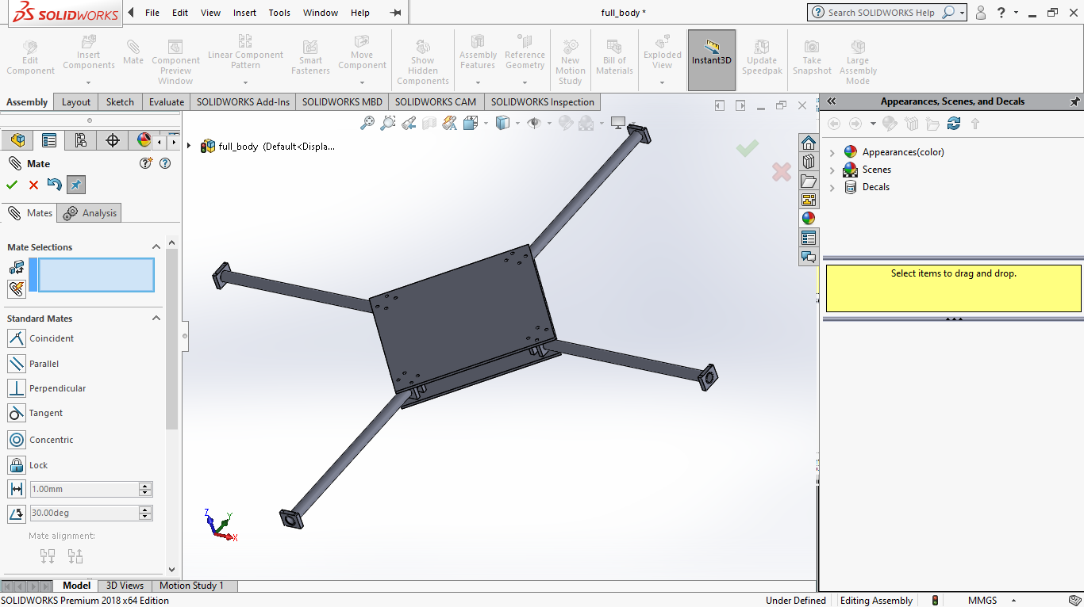
Drone Design
The body is designed as per dimension of a commercial drone.
Frame length : 150mm
Arm length = 200mm

Slide 3
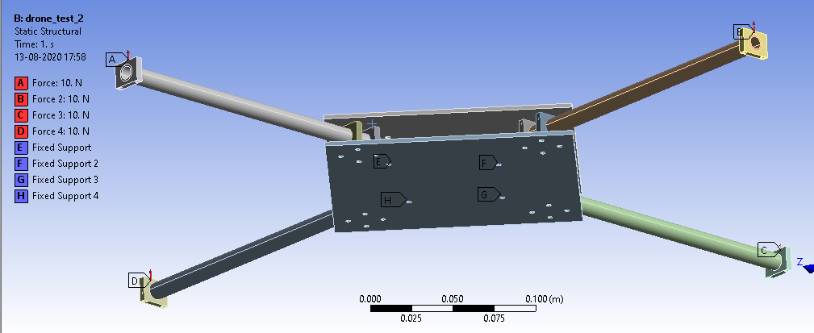
Force points
Forces on four arms in upwards direction of 10N each showed as A,B,C,D.
Fixed points acting as payload at bottom plate showed as E,F,G,H.

Slide 4
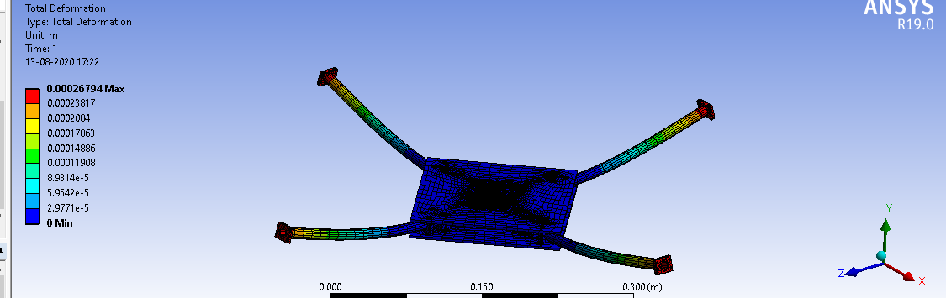
Total Deformation

Slide 5
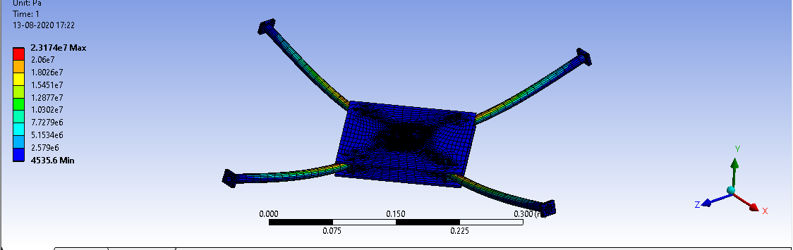
equivalent Stress

Slide 6
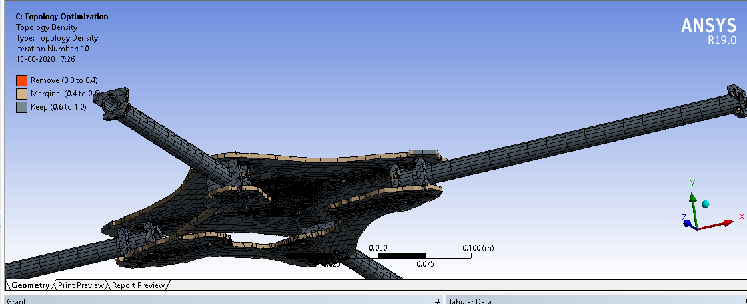
Topology optimization
Topology Optimization on Mass with percentage to retain at 70%.
Most of the base plate is removed since rest of the stress is being handeled by upper plate.

Slide 7
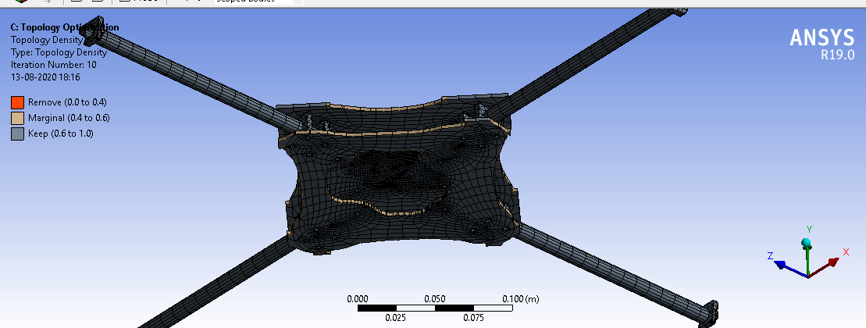
Topology optimization
Topology Optimization on Mass with percentage to retain at 80%.
In both of optimizations all other parameters were kept same i:e iterations = 500, Convergence accuracy = 0.1%,penalty factor = 3

Slide 8
Softwares used and conclusion
For designing and assembling Solidworks 2018 was used.
For structural analysis and topology optimization ANSYS was used.
This is a crude design which lack many components like screws, payload points, mounting brackets and landing gears.
This will lead to a different topology in future.

Slide 9
Thank You

